Slide 1
Discrete Mathematics
Relation

Slide 2
Learning Objectives
Learn about relations and their basic properties
Explore equivalence relations
Become aware of closures
Learn about posets

Slide 3

Relations
Relations are a natural way to associate objects of various sets
© Discrete Mathematical Structures: Theory and Applications

Slide 4
Representing Relations
Set – ordered pairs
Set definition – membership values
Arrow Diagram
Digraph (Directed Graph)

Slide 5
Relations
Arrow Diagram
  Write the elements of A in one column
  Write the elements B in another column
  Draw an arrow from an element, a, of A to an element, b, of B, if (a ,b) ∈ R
  Here, A = {2,3,5} and B = {7,10,12,30} and R from A into B is defined as follows: For all a ∈ A and b ∈ B, a R b if and only if a divides b
  The symbol → (called an arrow) represents the relation R
© Discrete Mathematical Structures: Theory and Applications

Slide 6
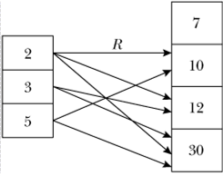
Relations
© Discrete Mathematical Structures: Theory and Applications

Slide 7
Relations
Directed Graph
  Let R be a relation on a finite set A
  Describe R pictorially as follows:
    For each element of A , draw a small or big dot and label the dot by the corresponding element of A
    Draw an arrow from a dot labeled a , to another dot labeled, b , if a R b .
    Resulting pictorial representation of R is called the directed graph representation of the relation R
© Discrete Mathematical Structures: Theory and Applications

Slide 8
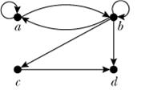
Relations
© Discrete Mathematical Structures: Theory and Applications

Slide 9
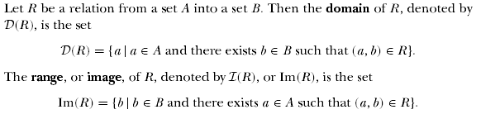
Relations
How do these definitions compare to Defn 12.5 on p732 in your book?
© Discrete Mathematical Structures: Theory and Applications

Slide 10
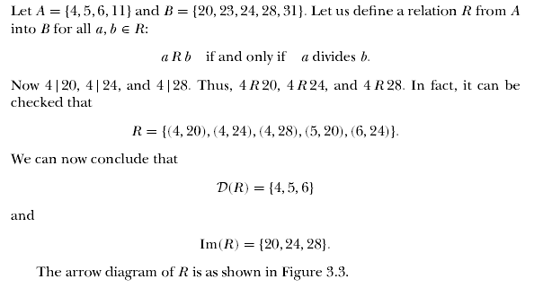
Relations
© Discrete Mathematical Structures: Theory and Applications

Slide 11
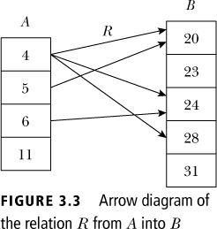
Relations
© Discrete Mathematical Structures: Theory and Applications

Slide 12

Inverse of Relations
  Let A = {1, 2, 3, 4} and B = {p, q, r}. Let R = {(1, q), (2, r ), (3, q), (4, p)}. Then R⁻¹ = {(q, 1), (r , 2), (q, 3), (p, 4)}
  To find R⁻¹, just reverse the directions of the arrows
  D(R) = {1, 2, 3, 4} = Im(R⁻¹), Im(R) = {p, q, r} = D(R⁻¹)
© Discrete Mathematical Structures: Theory and Applications

Slide 13
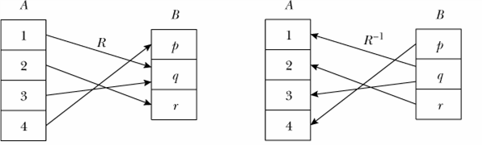
Inverse of Relations
© Discrete Mathematical Structures: Theory and Applications

Slide 14
Composition of Relations
Le R be a relations whose domain is A and whose image is B. Let S be a relation whose domain contains B and whose range is C. The composition of S and R is a subset of AXC. It is defined by:
Compositive is Associative

Slide 15
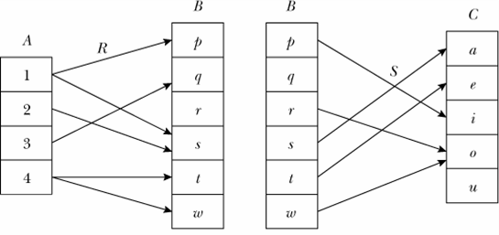
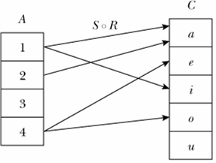
Composition of Relations
Example:
  Consider the relations R and S as given above
  The composition S ◦ R is shown on the right
© Discrete Mathematical Structures: Theory and Applications

Slide 16
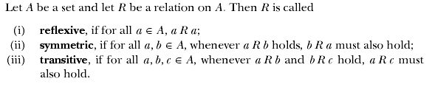
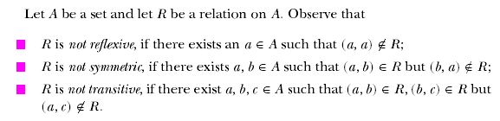
Properties of Relations
© Discrete Mathematical Structures: Theory and Applications

Slide 17

Equivalence Relations
© Discrete Mathematical Structures: Theory and Applications

Slide 18
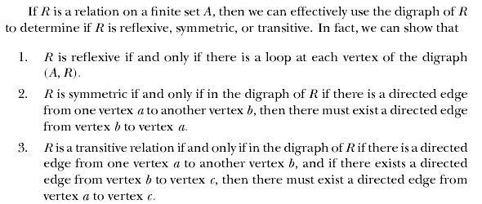
Equivalence Relations
© Discrete Mathematical Structures: Theory and Applications

Slide 19
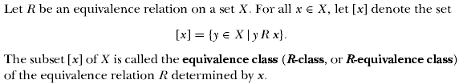
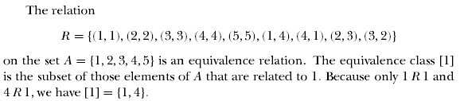
Equivalence Relations
© Discrete Mathematical Structures: Theory and Applications

Slide 20
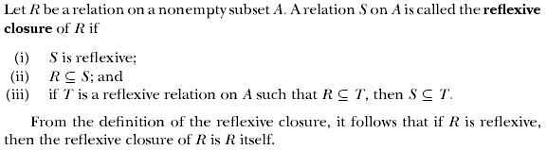
Closure of Properties on Relations
Compare to Definition 12.13 on p738 in your book
© Discrete Mathematical Structures: Theory and Applications

Slide 21
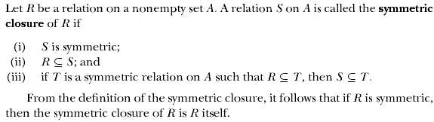
Closure of Properties on Relations
Compare to Definition 12.13 on p738 in your book
© Discrete Mathematical Structures: Theory and Applications

Slide 22
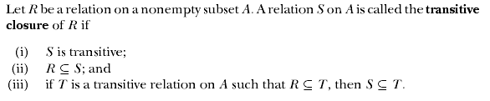
Closure of Properties on Relations
Compare to Definition 12.13 on p738 in your book
© Discrete Mathematical Structures: Theory and Applications

Slide 23
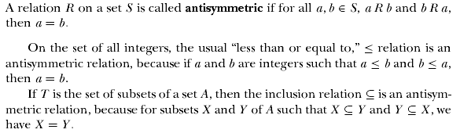
Partially Ordered Sets
© Discrete Mathematical Structures: Theory and Applications

Slide 24
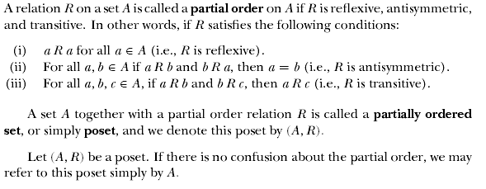
Partially Ordered Sets
© Discrete Mathematical Structures: Theory and Applications

Slide 25
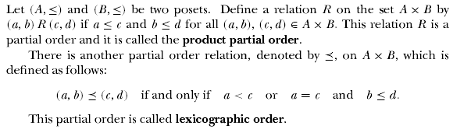
Partially Ordered Sets
© Discrete Mathematical Structures: Theory and Applications

Slide 26


Partially Ordered Sets
© Discrete Mathematical Structures: Theory and Applications

Slide 27
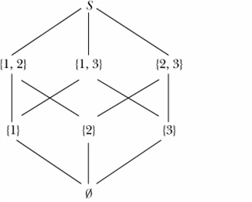
Partially Ordered Sets
Hasse Diagram
  Let S = {1, 2, 3}. Then P(S) = {∅, {1}, {2}, {3}, {1, 2}, {2, 3}, {1, 3}, S}
  Now (P(S),≤) is a poset, where ≤ denotes the set subset relation. The poset diagram of (P(S),≤) is shown

Slide 28
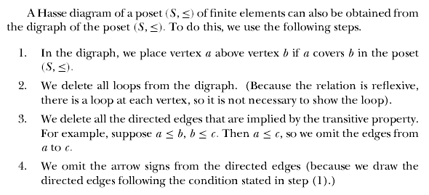
Partially Ordered Sets
© Discrete Mathematical Structures: Theory and Applications

Slide 29

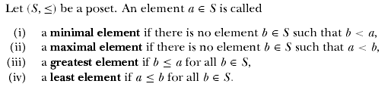
Partially Ordered Sets
© Discrete Mathematical Structures: Theory and Applications

Slide 30
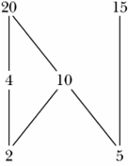
Partially Ordered Sets
Hasse Diagram
  Consider the poset (S,≤), where S = {2, 4, 5, 10, 15, 20} and the partial order ≤ is the divisibility relation.
  2 and 5 are the only minimal elements of this poset.
  This poset has no least element.
  20 and 15 are the only maximal elements of this poset.
  This poset has no greatest element.
© Discrete Mathematical Structures: Theory and Applications

Slide 31
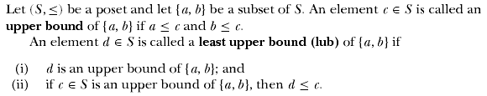
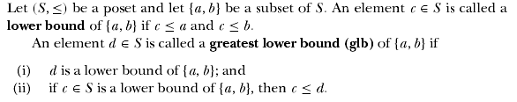
Partially Ordered Sets
© Discrete Mathematical Structures: Theory and Applications

